Slide 1

Challenges of Implementing a Just Culture
Eric Williams-Phillips
Bellevue University | CSD-380
Sue Sampson

Slide 2
What is a “just” culture?
As described by Brigham and Women’s Faulkner Hospital, a “just” culture is one in which organizations, specifically employees, are accountable for their choices and reporting issues
A just culture revolves around fairness, accountability, and transparency to ensure mistakes are fairly addressed individuals can safely learn from them

Slide 3
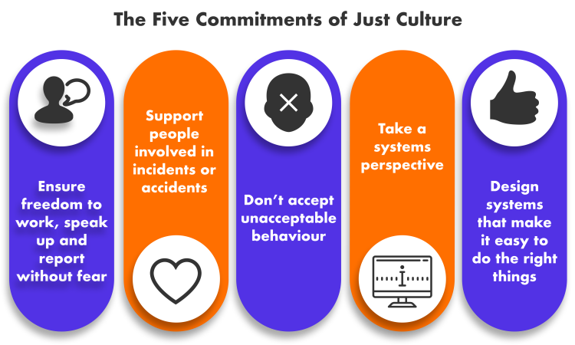

Slide 4
The Just Culture Company
The Just Culture Company is a part of a two-business unit with The Trajectories Company
The Trajectories Company exists to help organizations measure and respond to risk while The Just Culture company is there to help organizations reach a standard of accountability in the workplace
The Just Culture company provides learning material and certification to those looking to implement it in their own organizations

Slide 5
Conceptual Barrier
According to psychologist and “Just Culture” researcher Steven Shorrock, one of the challenges with creating an entire culture lies in “culture” itself
Culture takes time and re-enforcement to stick
Unfortunately, it isn’t an overnight change; as Steven says in his blog, “you can’t ‘design’, ‘engineer’, or ‘implement’ a culture of any kind
Culture cannot necessarily be enforced but can be spread by sharing values and practices

Slide 6
Perspective Barrier
All people have a completely different perspective on life than each other
A difference in values, beliefs, and habits can affect how we respond to each other’s mistakes
An important point that Steven mentions is that our judgement on mistakes can be heavily based on the severity of the mistake, hindsight after the outcome, and who is affected by that mistake
Because there are so many factors in determining a response, it can be difficult to provide confidence in their confession to everyone who makes a mistake

Slide 7
Psycological Barrier
One trouble of trying to spread a “just culture” in an existing workplace is dealing with a history of poor organizational reaction to mistakes
If there is a history of criminalization, individuals may be less likely to speak up when they notice something unsafe or make a mistake, which directly interferes with the idea of a Just Culture
Sometimes past events can stick around for a while , even after the individual who made the mistake is no longer with the company

Slide 8
Punitive Barrier
Like the previous challenge, individuals may have trouble coming forward if they believe their mistake will be reacted to unfairly
If a small mistake was previously heavily punished, who would want to admit to something larger?
Just based on my research for this assignment alone, I can tell “Just Culture” is extremely important in the medical field to prevent accidents or safety from being overlooked, making it even more important to coach rather than punish individuals following human error

Slide 9
Resources
Stevenshorrock, View All Posts By. “Why Is It Just so Difficult? Barriers to ‘Just Culture’ in the Real World.” Humanistic Systems, 27 May 2024, humanisticsystems.com/2023/10/18/why-is-it-just-so-difficult-barriers-to-just-culture-in-the-real-world.
Murray, John S., et al. “Implementing Just Culture to Improve Patient Safety.” Military Medicine, vol. 188, no. 7–8, May 2022, pp. 1596–99. https://doi.org/10.1093/milmed/usac115.
The Just Culture Company – the Learning Resource for Just Culture Proficiency. www.justculture.com.
The Just Culture Company. “The Just Culture Company | LinkedIn.” The Just Culture Company, www.linkedin.com/company/just-culture-company.
What Is Just Culture? Changing the Way We Think About Errors to Improve Patient Safety and Staff Satisfaction. www.brighamandwomensfaulkner.org/about-bwfh/news/what-is-just-culture-changing-the-way-we-think-about-errors-to-improve-patient-safety-and-staff-satisfaction.

